Slide 1
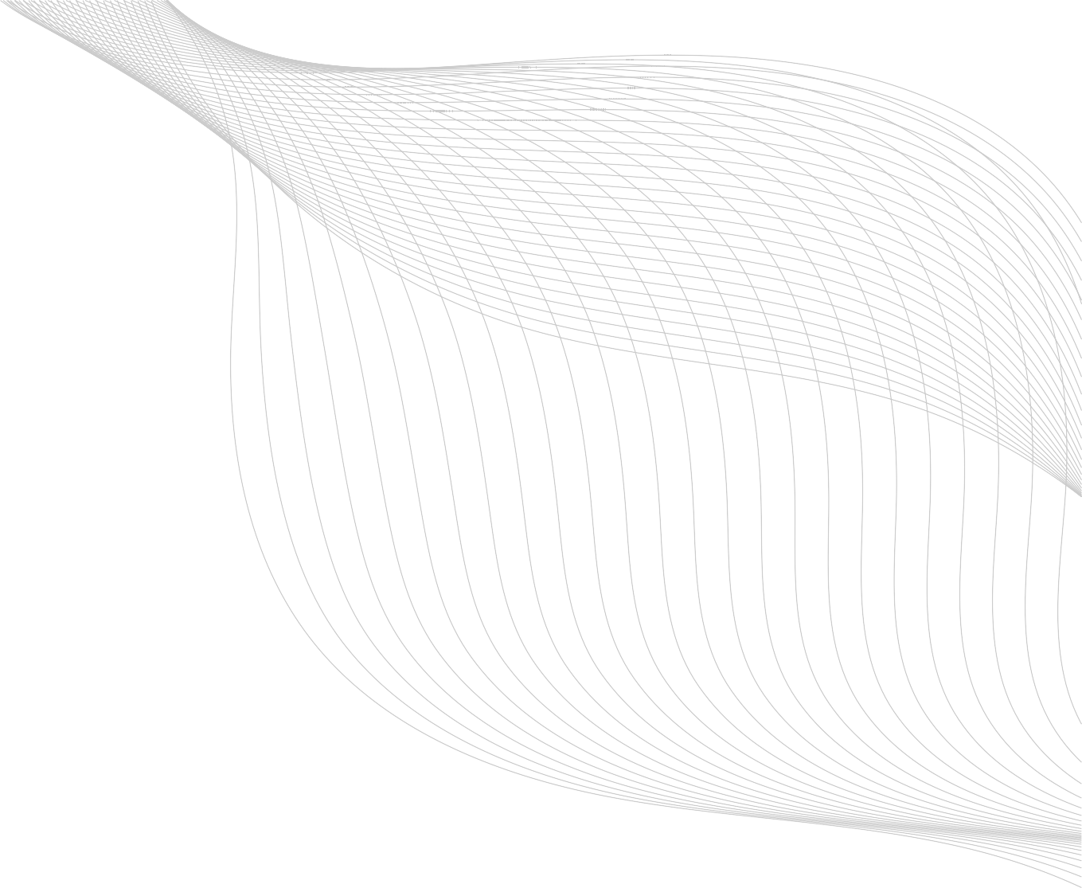

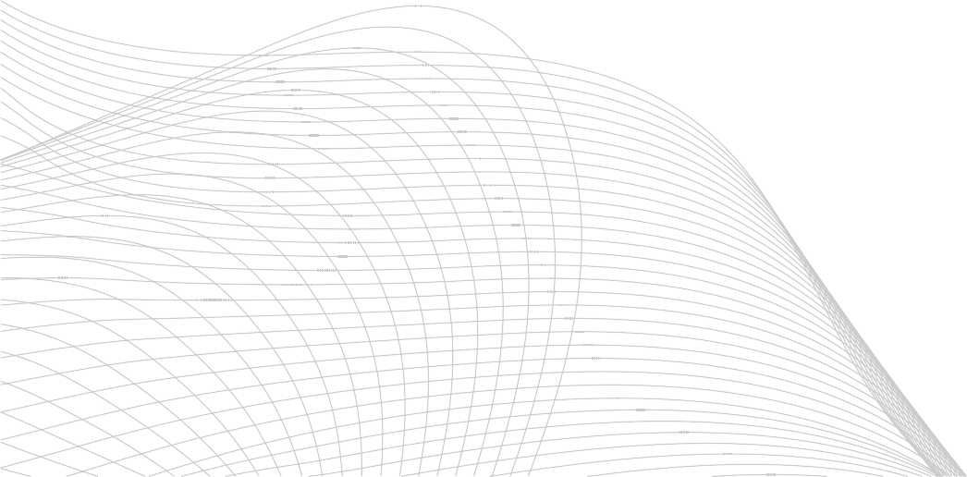
DIGITAL PROTFOLIO
STUDENT NAME: SURIYA PRAKASH T
REGISTER NO AND NMID:222404410 / 7903B0A8E24814BB0B04CA3A49609E71
DEPARTMENT: BSC COMPUTER SCIENCE
COLLEGE: AGURCHAND MANMULL JAIN COLLEGE

Slide 2
PROJECT TITLE
CREATING A STUDENT-DIGITAL PORTFOLIO USING THE HTML ,CSS AND JAVASCRIPT LANGUAGE.

Slide 3



AGENDA:
PROBLEM STATEMENT
PROJECT OVERVIEW
3 END USERS
TOOLS AND TECHNOLOGIES
PROTFOLIO DESIGNS AND LAYOUT
FEATURES AND FUNCTIONALITY
RESULTS AND SCREENSHOTS
8 CONCLUSION
9. GITHUB-LINK

Slide 4



PROBLEM STATEMENT
Many students struggling to present their skills,projects, and achievements in a profesional and accessible way. A personal portfolio websites helps to showcase our talents in online,making it easier to connect with recruiters,teachers and peers.

Slide 5


PROJECT OVERVIEW
@This project aims to create a student digital portfolio website using core web technologies – HTML, CSS, and JavaScript. The portfolio will serve as a personal website where a students can display their resume, projects, achievements, skills, and contact information.
*The design will be responsive, interactive, and easy to navigate. No backend is used, making the site lightweight and easily deployable.

Slide 6
END
USER
Students – who want to create and showcase their work online.
Teachers/Professors – to evaluate and give feedback on student achievements.
Academic Institutions – to help students present their digital identity.

Slide 7


TOOLS AND TECHNOLOGIES
HTML
for structure and content of the web pages.
CSS
for styling, layout, animations, and responsiveness.
JAVASCRIPT
for interactive features like form validation, modals, and navigation.

Slide 8
TOOLS AND TECHNOLOGIES
VS CODE
as the code editor.
GITHUB
or version control and deployment.

Slide 9

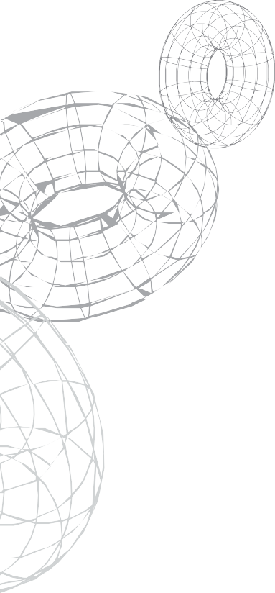

PORTFOLIO DESIGN AND LAYOUT
Header – Logo and navigation bar.
Hero Section – Introduction with name, and greetings About Me – Brief background and personal statement. Education – Academic history.
Skills – Technical and soft skills displayed using icons or bars. Projects – Cards or grid layout for projects with names and details. Contact Me – Contact form and social media links.
Footer – Basic copyright and quick links.

Slide 10




FEATURES AND FUNCTIONALITY
Responsive Design – Works across devices (desktop, tablet, mobile)
Interactive Navigation – Smooth scrolling and active state highlighting
Contact Form – With client-side validation using JavaScript Project Gallery – Clickable projects with modal popups or external links
Animations – On scroll reveal using CSS or JS libraries

Slide 11

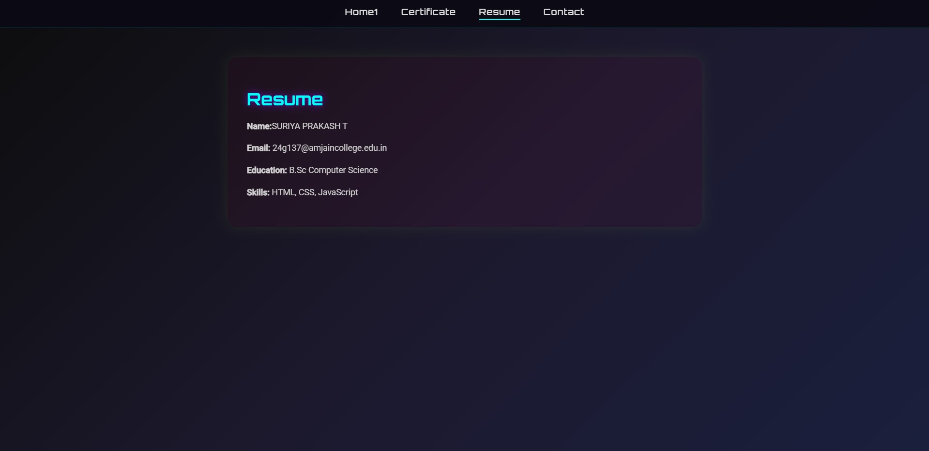
RESULTS AND SCREENSHOT
here is my student portfolio result screenshot and screenshot of assignments are uploaded in weekly milestone in edunet foundation student dashboard

Slide 12


CONCLUSION
The student digital portfolio project successfully demonstrates the power of web technologies in building a personal branding platform. It is simple yet effective in allowing students to organize and present their work online. The project promotes self- expression, digital literacy, and enhances professional visibility for students in academic and career settings.e

Slide 13

THANK YOU

